Slide 1


Mohd Irfan Qureshi 12/12/2023

Slide 2
Outline
Executive Summary
Introduction
Methodology
Results
Conclusion
Appendix

Slide 3
Executive Summary
Summary of methodologies
Data Collection via API, Web Scraping
Exploratory Data Analysis (EDA) with Data Visualization
EDA with SQL
Interactive Map with Folium
Dashboards with Plotly Dash
Predictive Analysis
Summary of all results
Exploratory Data Analysis results
Interactive maps and dashboard
Predictive results

Slide 4
Introduction
Project background and context
The aim of this project is to predict if the Falcon 9 first stage will successfully land. SpaceX says on its website that the Falcon 9 rocket launch cost 62 million dollars. Other providers cost upward of 165 million dollars each. The price difference is explained by the fact that SpaceX can reuse the first stage. By determining if the stage will land, we can determine the cost of a launch. This information is interesting for another company if it wants to compete with SpaceX for a rocket launch.
Problems you want to find answers
What are the main characteristics of a successful or failed landing ?
What are the effects of each relationship of the rocket variables on the success or failure of a landing ?
What are the conditions which will allow SpaceX to achieve the best landing success rate ?

Slide 5

5

Slide 6
Methodology
Executive Summary
Data collection methodology:
SpaceX REST API
Web Scrapping from Wikipedia
Perform data wrangling
Dropping unnecessary columns
One Hot Encoding for classification models
Perform exploratory data analysis (EDA) using visualization and SQL
Perform interactive visual analytics using Folium and Plotly Dash
Perform predictive analysis using classification models
How to build, tune, evaluate classification models
6

Slide 7
Data Collection
Datasets are collected from Rest SpaceX API and webscrapping Wikipedia
The information obtained by the API are rocket, launches, payload information.
The Space X REST API URL is api.spacexdata.com/v4/
SpaceX Rest API call
Make
Dataframe
from JSON
Clean Data and export it
API returns JSON file
The information obtained by the webscrapping of Wikipedia are launches, landing, payload information.
URL is https://en.wikipedia.org/w/index.php?title=List_of_Falcon_9_and_Falcon_Heavy_launches&oldid=1027686922
Get HTML
response from Wikipedia
Extract data with BeautifulSoup
Make Dataframe
Export Data
7

Slide 8
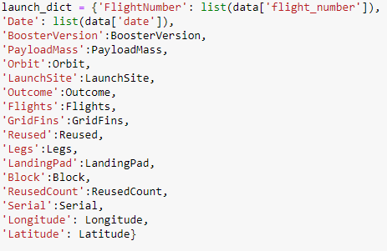


Data Collection – SpaceX API
1. Getting Response from API
5. Create dataframe
4. Create dictionary with data
2. Convert Response to JSON File
6. Filter dataframe
3. Transform data
7. Export to file

Slide 9
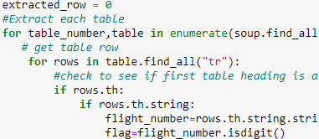
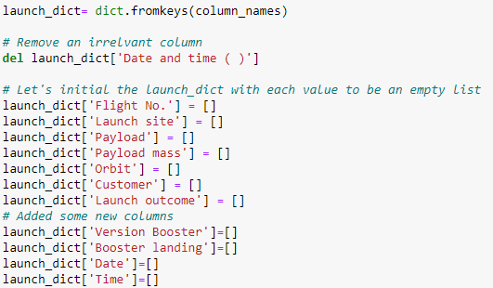

Data Collection - Scraping
6. Add data to keys
1. Getting Response from HTML
5. Create dictionary
2. Create BeautifulSoup Object
See notebook for the rest of code
3. Find all tables
7. Create dataframe from dictionary
4. Get column names
8. Export to file

Slide 10

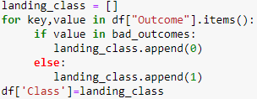
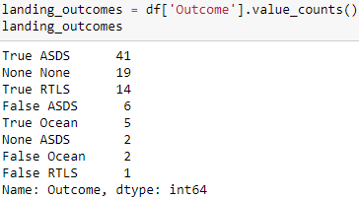
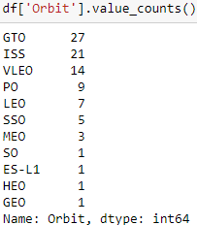
Data Wrangling
In the dataset, there are several cases where the booster did not land successully.
True Ocean, True RTLS, True ASDS means the mission has been successful.
False Ocean, False RTLS, False ASDS means the mission was a failure.
We need to transform string variables into categorical variables where 1 means the mission has been successful and 0 means the mission was a failure.
1. Calculate launches number for each site
3. Calculate number and occurrence of
mission outcome per orbit type
4. Create landing outcome label from Outcome column
2. Calculate the number and occurence of each orbit
5. Export to file
10

Slide 11



EDA with Data Visualization
Scatter Graphs
Flight Number vs. Payload Mass
Flight Number vs. Launch Site
Payload vs. Launch Site
Orbit vs. Flight Number
Payload vs. Orbit Type
Orbit vs. Payload Mass
Scatter plots show relationship between
variables. This relationship is called the correlation.
Bar Graph
Success rate vs. Orbit
Bar graphs show the relationship between
numeric and categoric variables.
Line Graph
Success rate vs. Year
Line graphs show data variables and their trends. Line graphs can help to show global behavior and make prediction for unseen data.
11

Slide 12
EDA with SQL
We performed SQL queries to gather and understand data from dataset:
Displaying the names of the unique lauunch sites in the space mission.
Display 5 records where launch sites begin with the string 'CCA'
Display the total payload mass carried by boosters launched by NASA (CRS).
Display average payload mass carried by booster version F9 v1.1.
List the date when the first successful landing outcome in ground pad was achieved.
List the names of the boosters which have success in drone ship and have payload mass greater than 4000 but less than 6000.
List the total number of successful and failure mission outcomes.
List the names of the booster_versions which have carried the maximum payload mass.
List the records which will display the month names, faiilure landing_ouutcomes in drone ship, booster versions, launch_site for the months in year 2015.
Rank the count of successful landiing_outcomes between the date 04-06-2010 and 20-03-2017 in descending order.

Slide 13
Build an Interactive Map with Folium
Folium map object is a map centered on NASA Johnson Space Center at Houson, Texas
Red circle at NASA Johnson Space Center's coordinate with label showing its name (folium.Circle, folium.map.Marker).
Red circles at each launch site coordinates with label showing launch site name (folium.Circle, folium.map.Marker, folium.features.DivIcon).
The grouping of points in a cluster to display multiple and different information for the same coordinates
(folium.plugins.MarkerCluster).
Markers to show successful and unsuccessful landings. Green for successful landing and Red for unsuccessful landing.
(folium.map.Marker, folium.Icon).
Markers to show distance between launch site to key locations (railway, highway, coastway, city) and plot a line between them.
(folium.map.Marker, folium.PolyLine, folium.features.DivIcon)
These objects are created in order to understand better the problem and the data. We can show easily all launch sites, their surroundings and the number of successful and unsuccessful landings.

Slide 14
Build a Dashboard with Plotly Dash
Dashboard has dropdown, pie chart, rangeslider and scatter plot components
Dropdown allows a user to choose the launch site or all launch sites
(dash_core_components.Dropdown).
Pie chart shows the total success and the total failure for the launch site chosen with the dropdown component (plotly.express.pie).
Rangeslider allows a user to select a payload mass in a fixed range
(dash_core_components.RangeSlider).
Scatter chart shows the relationship between two variables, in particular Success vs Payload Mass (plotly.express.scatter).
14

Slide 15
Predictive Analysis (Classification)
Data preparation
Load dataset
Normalize data
Split data into training and test sets.
Model preparation
Selection of machine learning algorithms
Set parameters for each algorithm to GridSearchCV
Training GridSearchModel models with training dataset
Model evaluation
Get best hyperparameters for each type of model
Compute accuracy for each model with test dataset
Plot Confusion Matrix
Model comparison
Comparison of models according to their accuracy
The model with the best accuracy will be chosen (see Notebook for result)
15

Slide 16
Results
Exploratory data analysis results
Interactive analytics demo in screenshots
Predictive analysis results
16

Slide 17





Insights drawn
Section 2
from EDA

Slide 18
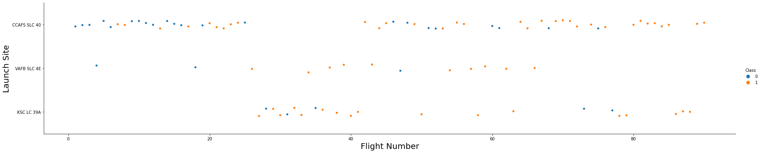
Flight Number vs. Launch Site
We observe that, for each site, the success rate is increasing.

Slide 19
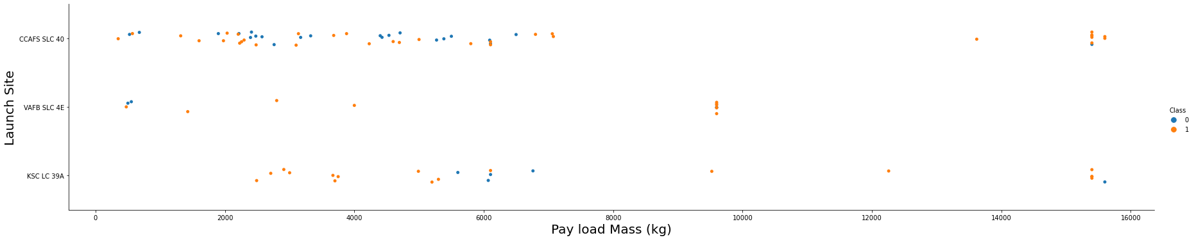
Payload vs. Launch Site
Depending on the launch site, a heavier payload may be a consideration for a successful landing. On the other hand, a too heavy payload can make a landing fail.

Slide 20
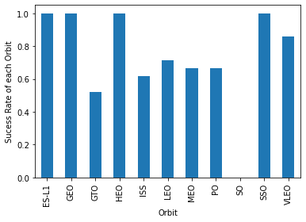
Success Rate vs. Orbit Type
With this plot, we can see success rate for different orbit types. We note that ES-L1, GEO, HEO, SSO have the best success rate.
20

Slide 21
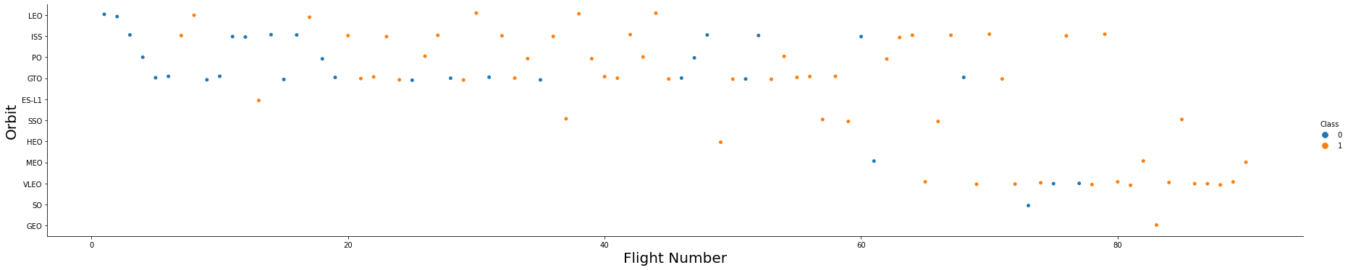
Flight Number vs. Orbit Type
We notice that the success rate increases with the number of flights for the LEO orbit. For some orbits like GTO, there is no relation between the success rate and the number of flights. But we can suppose that the high success rate of some orbits like SSO or HEO is due to the knowledge learned during former launches for other orbits.

Slide 22
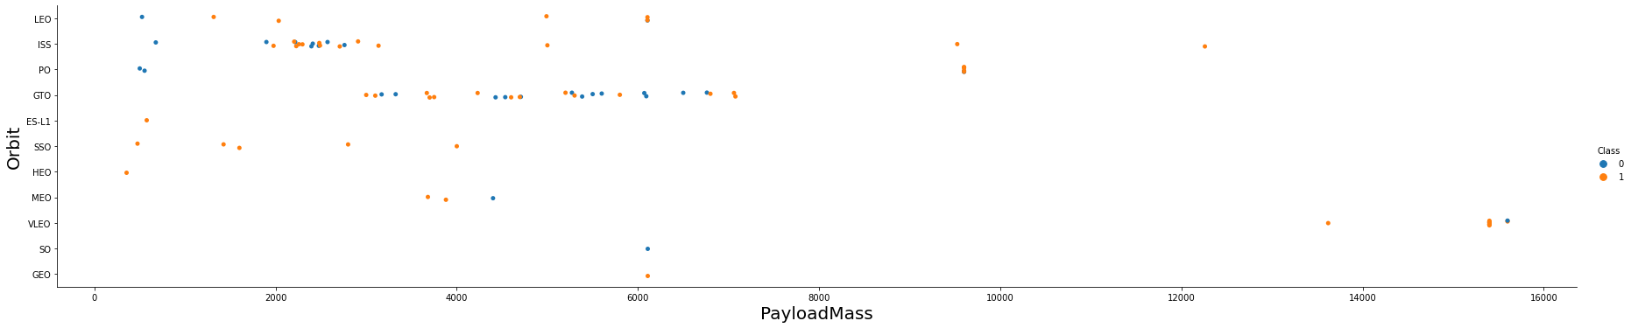
Payload vs. Orbit Type
The weight of the payloads can have a great influence on the success rate of the launches in certain orbits. For example, heavier payloads improve the success rate for the LEO orbit. Another finding is that decreasing the payload weight for a GTO orbit improves the success of a launch.

Slide 23
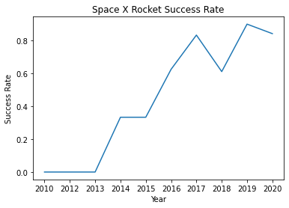
Launch Success Yearly Trend
Since 2013, we can see an increase in the Space X Rocket success rate.

Slide 24
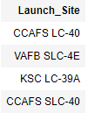
All Launch Site Names
SQL Query
Results
Explanation
The use of DISTINCT in the query allows to remove duplicate LAUNCH_SITE.

Slide 25
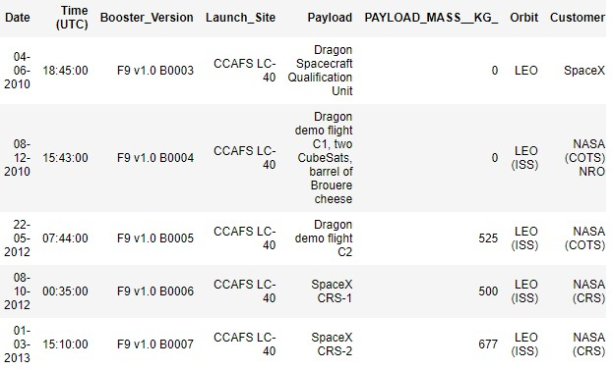
Launch Site Names Begin with 'CCA'
SQL Query
Results
Explanation
The WHERE clause followed by LIKE clause filters launch sites that contain the substring CCA. LIMIT 5 shows 5 records from filtering.

Slide 26

Total Payload Mass
SQL Query
Results
Explanation
This query returns the sum of all payload masses where the customer is NASA (CRS).

Slide 27

Average Payload Mass by F9 v1.1
SQL Query
Results
Explanation
This query returns the average of all payload masses where the booster version contains the substring F9 v1.1.

Slide 28

First Successful Ground Landing Date
SQL Query
Results
Explanation
With this query, we select the oldest successful landing.
The WHERE clause filters dataset in order to keep only records where landing was successful. With the MIN function, we select the record with the oldest date.

Slide 29
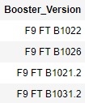
Successful Drone Ship Landing with Payload between 4000 and 6000
SQL Query
Results
Explanation
This query returns the booster version where landing was successful and payload mass is between 4000 and 6000 kg. The WHERE and AND clauses filter the dataset.

Slide 30

Total Number of Successful and Failure Mission Outcomes
SQL Query
Results
Explanation
With the first SELECT, we show the subqueries that return results. The first subquery counts the successful mission. The second subquery counts the unsuccessful mission. The WHERE clause followed by LIKE clause filters mission outcome. The COUNT function counts records filtered.

Slide 31
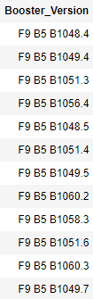
Boosters Carried Maximum Payload
SQL Query
Results
Explanation
We used a subquery to filter data by returning only the heaviest payload mass with MAX function. The main query uses subquery results and returns unique booster version (SELECT DISTINCT) with the heaviest payload mass.

Slide 32

2015 Launch Records
SQL Query
Results
Explanation
This query returns month, booster version, launch site where landing was unsuccessful and landing date took place in 2015. Substr function process date in order to take month or year. Substr(DATE, 4, 2) shows month. Substr(DATE,7, 4) shows year.

Slide 33
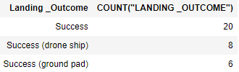
Rank Landing Outcomes Between 2010-06-04 and 2017-03-20
SQL Query
Results
Explanation
This query returns landing outcomes and their count where mission was successful and date is
between 04/06/2010 and 20/03/2017. The GROUP BY clause groups results by landing outcome and ORDER BY COUNT DESC shows results in decreasing
order.

Slide 34
Launch Sites
Section 4
Proximities Analysis

Slide 35
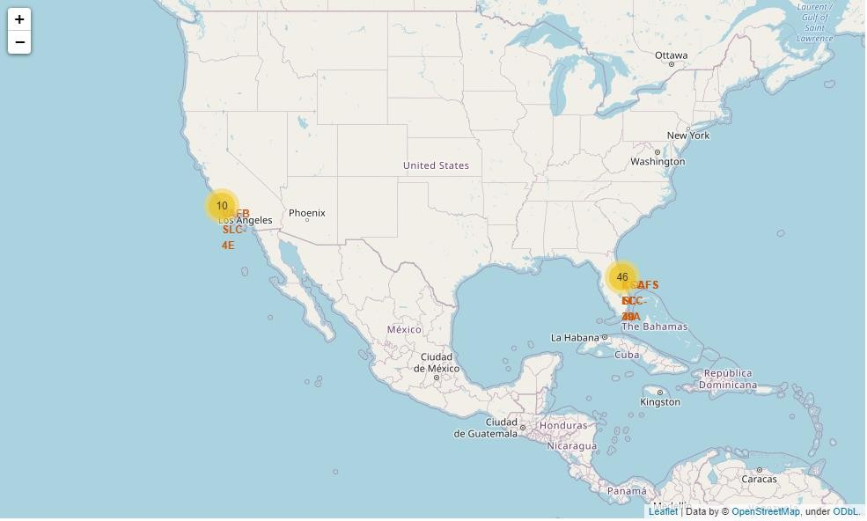
Folium map – Ground stations
We see that Space X launch sites are located on the coast of the United States
35

Slide 36
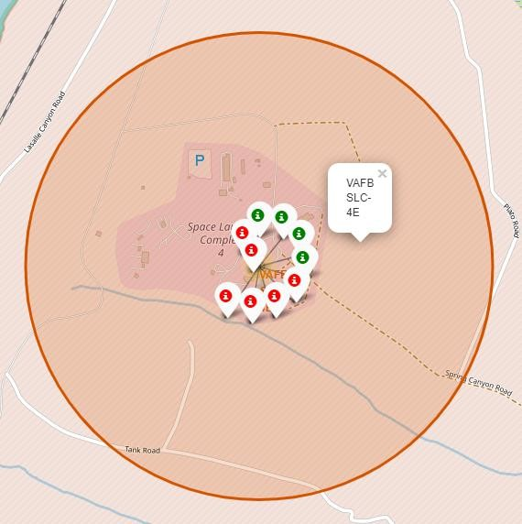
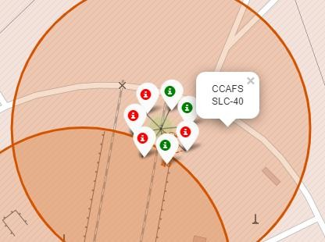
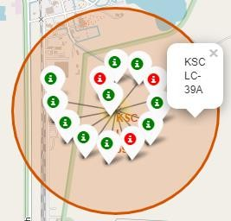
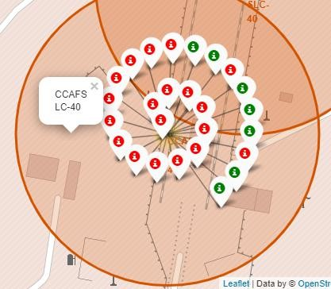
Folium map – Color Labeled Markers
Green marker represents successful launches. Red marker represents unsuccessful launches. We note that KSC LC-39A has a higher launch success rate.
36

Slide 37
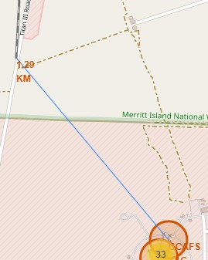
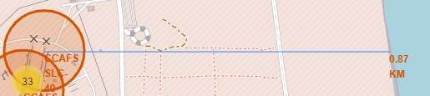
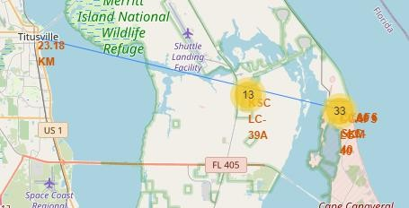
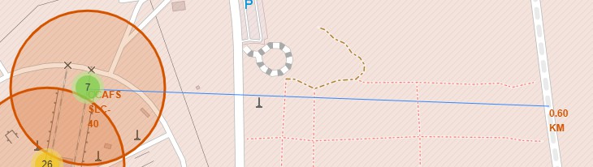
Folium Map – Distances between CCAFS SLC-40 and its proximities
Is CCAFS SLC-40 in close proximity to railways ? Yes Is CCAFS SLC-40 in close proximity to highways ? Yes Is CCAFS SLC-40 in close proximity to coastline ? Yes
Do CCAFS SLC-40 keeps certain distance away from cities ? No
37

Slide 38

Build a Dashboard
Section 5
.
with Plotly Dash

Slide 39
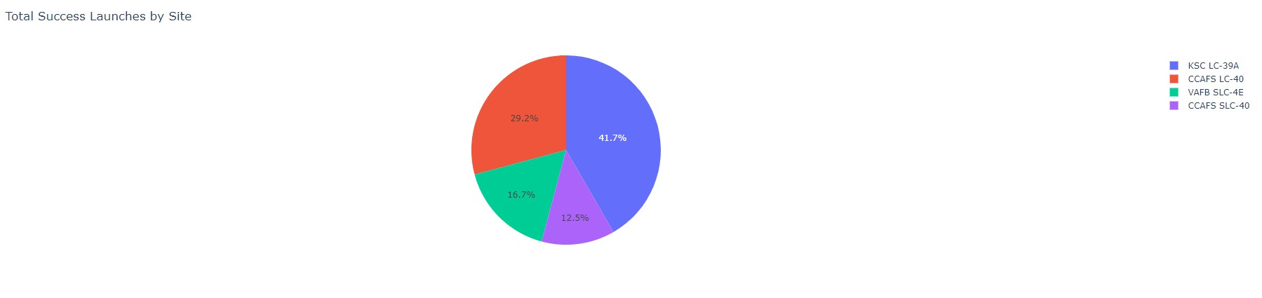
Dashboard – Total success by Site
We see that KSC LC-39A has the best success rate of launches.

Slide 40
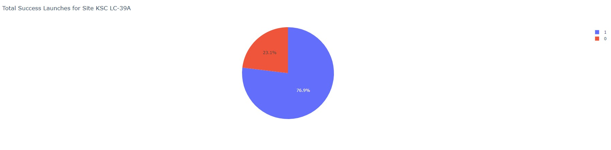
Dashboard – Total success launches for Site KSC LC-39A
We see that KSC LC-39A has achieved a 76.9% success rate while getting a 23.1% failure rate.

Slide 41
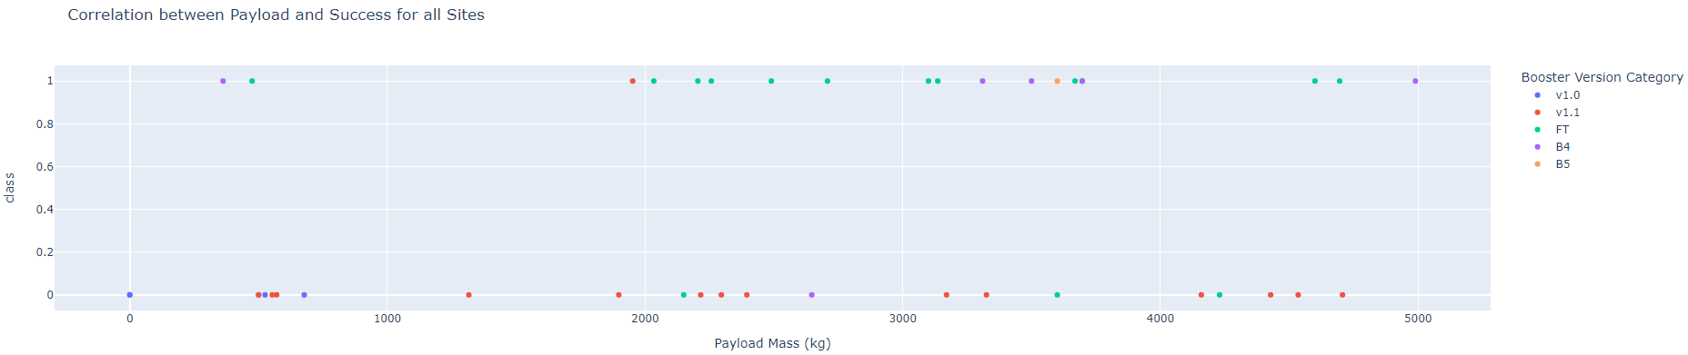
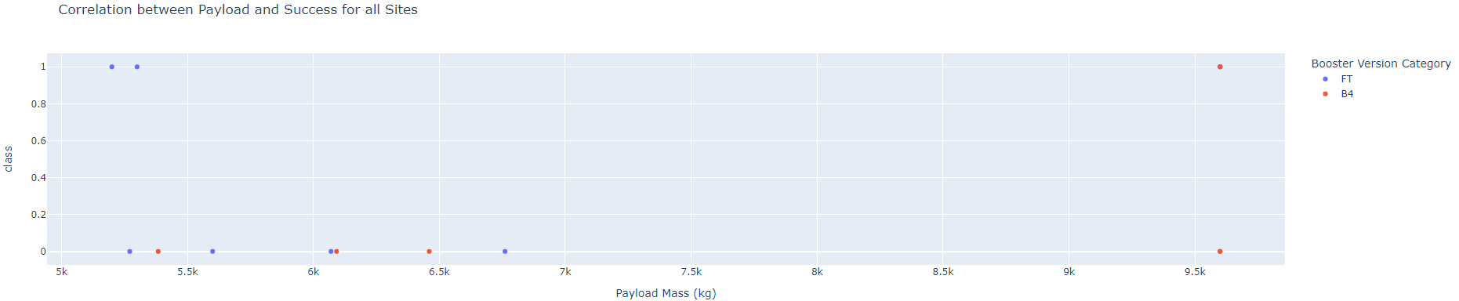
Dashboard – Payload mass vs Outcome for all sites with different payload mass selected
Low weighted payload (0 – 5000 kg)
Heavy weighted payload (5000 – 10000 kg)
Low weighted payloads have a better success rate than the heavy weighted payloads.

Slide 42
Predictive Analysis
Section 6
(Classification)

Slide 43
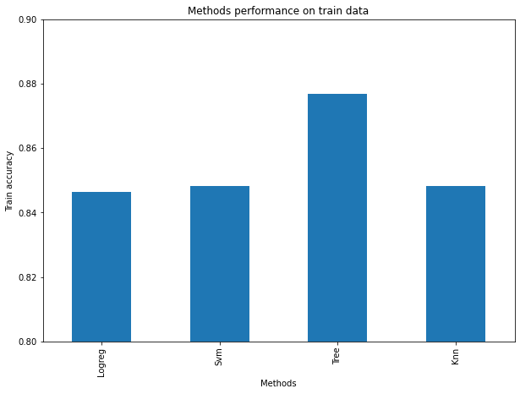
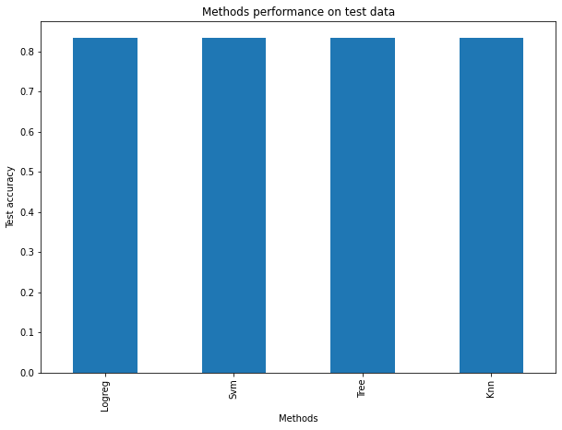
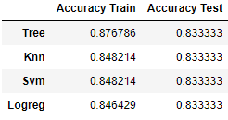
Classification Accuracy
For accuracy test, all methods performed similar. We could get more test data to decide between them. But if we really need to choose one right now, we would take the decision tree.
Decision tree best parameters

Slide 44
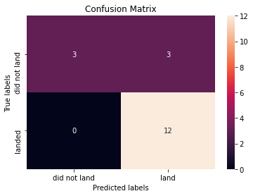
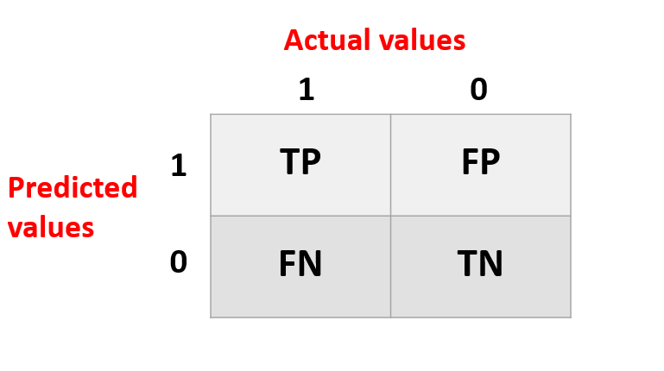
Confusion Matrix
Logistic regression
Decision Tree
As the test accuracy are all equal, the confusion matrices are also identical. The main problem of these models are false positives.
kNN
SVM

Slide 45
Conclusions
The success of a mission can be explained by several factors such as the launch site, the orbit and especially the number of previous launches. Indeed, we can assume that there has been a gain in knowledge between launches that allowed to go from a launch failure to a success.
The orbits with the best success rates are GEO, HEO, SSO, ES-L1.
Depending on the orbits, the payload mass can be a criterion to take into account for the success of a mission. Some orbits require a light or heavy payload mass. But generally low weighted payloads perform better than the heavy weighted payloads.
With the current data, we cannot explain why some launch sites are better than others (KSC LC-39A is the best launch site). To get an answer to this problem, we could obtain atmospheric or other relevant data.
For this dataset, we choose the Decision Tree Algorithm as the best model even if the test accuracy between all the models used is identical. We choose Decision Tree Algorithm because it has a better train accuracy.

Slide 46


